Slide 1

Chapter 2
Intelligent Agents

Slide 2
1.5 AGENTS AND ENVIRONMENTS
What is an Agent?
“An agent can be anything that perceive its environment through sensors and act upon that environment through actuators”(a device that causes a machine or other device to operate).
An Agent runs in the cycle of perceiving (to notice or realize something), thinking, and acting.
An agent can be:
  Human-Agent: A human agent has eyes, ears, and other organs which work for sensors and hand, legs, vocal tract work for actuators.
  Robotic Agent: A robotic agent can have cameras, infrared range finder, NLP for sensors and various motors for actuators.
  Software Agent: Software agent can have keystrokes, file contents as sensory input and act on those inputs and display output on the screen.
Hence the world around us is full of agents such as, cellphone, camera, and even we are also agents.
Sensor: Sensor is a device which detects the change in the environment and sends the information to other electronic devices. An agent observes its environment through sensors.

Slide 3
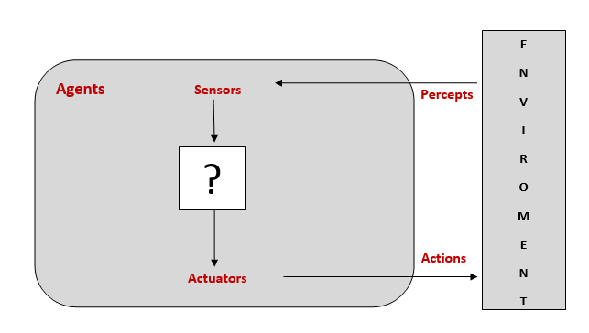
Actuators: Actuators are the component of machines that converts energy into motion. The actuators are only responsible for moving and controlling a system. An actuator can be an electric motor, gears, rails, etc.
Effectors: Effectors are the devices which affect the environment. Effectors can be legs, wheels, arms, fingers, wings, fins, and display screen.
Agents interact with environments through sensors and actuators.

Slide 4

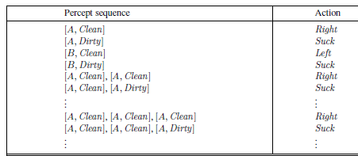
In the simple world, the vacuum cleaner agent has a location sensor and a dirt sensor so that it knows where it is (room A or room B) and whether the room is dirty.
It can go left, go right, suck, and idle. A possible performance
measure is to maximize the number of clean rooms over a certain period.
Imagine that our intelligent agent is a robot vacuum cleaner.
Let's us consider that the environment has just two
rooms.
The robot can be in either room and there can be
dirt in zero, one, or two rooms.

Slide 5
1.6 GOOD BEHAVIOR: THE CONCEPT OF RATIONALITY
A rational agent is one that does the right thing that is the right actions will cause the agent to be most successful in the environment.
A rational agent is one that does the right thing—conceptually speaking, every entry in the table for the agent function is filled out correctly.
Obviously, doing the right thing is better than doing the wrong thing, but what does it mean to do the right thing?
By considering the consequences of the agent’s behavior, When an agent is plunked down in an environment, it generates a sequence of actions according to the percepts it receives.
This sequence of actions causes the environment to go through a sequence of states. If the sequence is desirable, then the agent has performed well.
This notion of desirability is captured by a performance measure that evaluates any given sequence of environment states.
Performance measures
A performance measures embodies the criterion for success of an agent‘s behavior.
As a general rule, it is better to design performance measures according to what one actually wants in the environment, rather than according to how one thinks the agent should behave.

Slide 6
Rationality
What is rational at any given time depends on four things:
  The performance measure that defines the criterion of success.
  The agent’s prior knowledge of the environment.
  The actions that the agent can perform.
  The agent’s percept sequence to date.
This leads to a definition of a rational agent (ideal rational agent)
“For each possible percept sequence, a rational agent should select an action that is expected to maximize its performance measure, given the evidence provided by the percept sequence and whatever built-in knowledge the agent has, that is the task of rational agent is to improve the performance measure depends on percept sequence”.
Consider the simple vacuum-cleaner agent that cleans a square if it is dirty and moves to the other square if not; this is the agent function tabulated in Figure. Is this a rational agent? That depends!
First, we need to say what the performance measure is, what is known about the environment, and what sensors and actuators the agent has.
Let us assume the following.

Slide 7
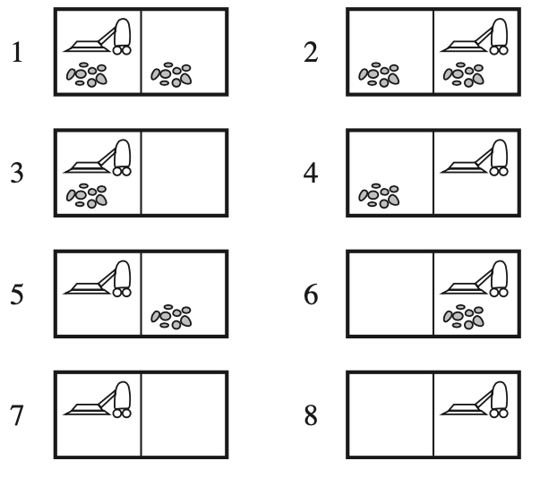
The performance measure awards one point for each clean square at each time step, over a “lifetime” of 1000 time steps.
The “geography” of the environment is known a priori (Figure) but the dirt distribution and the initial location of the agent are not. Clean squares stay clean and sucking cleans the current square.
The Left and Right actions move the agent left and right except when this would take the agent outside the environment, in which case the agent remains where it is.
The only available actions are Left, Right, and Suck.
The agent correctly perceives its location and whether that location contains dirt.

Slide 8
Omniscience, learning, and autonomy
An omniscient agent knows the actual outcome of its actions and can act accordingly; but omniscience is impossible in reality.
A rational agent not only to gather information, but also to learn as much as possible from what it perceives.
The agent‘s initial configuration could reflect some prior knowledge of the environment, but as the agent gains experience this may be modified and augmented.
Successful agents split the task of computing the agent function into three different periods:
  when the agent is being designed, some of the computation is done by its designers;
  when it is deliberating on its next action, the agent does more computation and
  as it learns from experience, it does even more computation to decide how to modify its behavior.
A rational agent should be autonomous – it should learn what it can, to compensate for partial or incorrect prior knowledge.

Slide 9
1.7 THE NATURE OF ENVIRONMENTS
The environment is the Task Environment (problem) for which the Rational Agent is the solution. Any task environment is characterized on the basis of PEAS.
Performance – What is the performance characteristic which would either make the agent successful or not. For example, as per the previous example clean floor, optimal energy consumption might be performance measures.
Environment – Physical characteristics and constraints expected. For example, wood floors, furniture in the way etc.
Actuators – The physical or logical constructs which would take action. For example for the vacuum cleaner, these are the suction pumps
Sensors – Again physical or logical constructs which would sense the environment. From our previous example, these are cameras and dirt sensors.

Slide 10
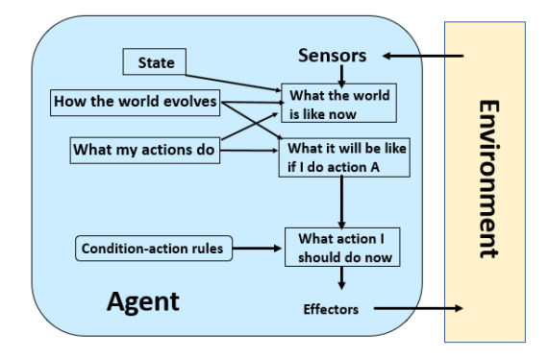

Slide 11
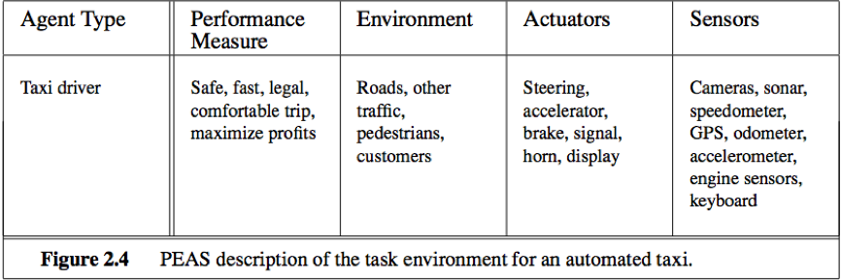
Specifying the task environment
The PEAS description for the taxi’s task environment. We discuss each element in more detail in the following paragraphs.
First, what is the performance measure to which we would like our automated driver to aspire?
  Desirable qualities include getting to the correct destination;
  minimizing fuel consumption;
  minimizing the trip time or cost;
  minimizing violations of traffic laws and disturbances to other drivers;
  maximizing safety and passenger comfort; maximizing profits.
Obviously, some of these goals conflict, so tradeoffs will be required.

Slide 12
Next, what is the driving environment that the taxi will face?
  Any taxi driver must deal with a variety of roads, ranging from rural lanes and urban alleys to 12-lane freeways.
  The roads contain other traffic, pedestrians, stray animals, road works, police cars . The taxi must also interact with potential and actual passengers.
The actuators for an automated taxi include those available to a human driver:
  control over the engine through the accelerator and control over steering and braking.
  In addition, it will need output to a display screen or voice synthesizer to talk back to the passengers, and perhaps some way to communicate with other vehicles, politely or otherwise.
The basic sensors for the taxi will include one or more controllable video cameras so that it can see the road;
  it might augment these with infrared or sonar sensors to detect distances to other cars and obstacle.

Slide 13
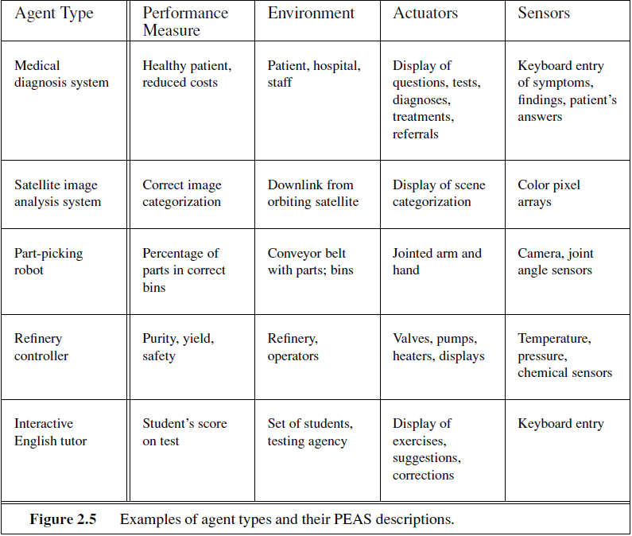
we have sketched the basic PEAS elements for a number of additional agent types

Slide 14
Properties of task environments
An environment in artificial intelligence is the surrounding of the agent. The agent takes input from the environment through sensors and delivers the output to the environment through actuators.
There are several types of environments:
                Fully Observable vs Partially Observable
                Deterministic vs Stochastic
                Competitive vs Collaborative
                Single-agent vs Multi-agent
                Static vs Dynamic
                Discrete vs Continuous
                Episodic vs sequential
                Known vs Unknown
                Accessible vs Inaccessible

Slide 15
Fully Observable vs Partially Observable
When an agent sensor is capable to sense or access the complete state of an agent at each point in time, it is said to be a fully observable environment else it is partially observable.
Maintaining a fully observable environment is easy as there is no need to keep track of the history of the surrounding.
An environment is called unobservable when the agent has no sensors in all environments.
Example:
  Chess – the board is fully observable, so are the opponent’s moves
  Driving – the environment is partially observable because what’s around the corner is not know.
Deterministic vs Stochastic
When a uniqueness in the agent’s current state completely determines the next state of the agent, the environment is said to be deterministic.
The stochastic environment is random in nature which is not unique and cannot be completely determined by the agent.
Example:
Chess – there would be only a few possible moves for a coin at the current state and these moves can be determined.
Self Driving Cars – the actions of a self-driving car are not unique, it varies time to time.

Slide 16
Competitive vs Collaborative
An agent is said to be in a competitive environment when it competes against another agent to optimize the output.
The game of chess is competitive as the agents compete with each other to win the game which is the output.
An agent is said to be in a collaborative environment when multiple agents cooperate to produce the desired output.
When multiple self-driving cars are found on the roads, they cooperate with each other to avoid collisions and reach their destination which is the output desired.
Single-agent vs Multi-agent
An environment consisting of only one agent is said to be a single-agent environment.
A person left alone in a maze is an example of the single-agent system.
An environment involving more than one agent is a multi-agent environment.
The game of football is multi-agent as it involves 11 players in each team.

Slide 17
Dynamic vs Static
An environment that keeps constantly changing itself when the agent is up with some action is said to be dynamic.
A roller coaster ride is dynamic as it is set in motion and the environment keeps changing every instant.
An idle environment with no change in its state is called a static environment.
An empty house is static as there’s no change in the surroundings when an agent enters.
Discrete vs Continuous
If an environment consists of a finite number of actions that can be deliberated in the environment to obtain the output, it is said to be a discrete environment.
The game of chess is discrete as it has only a finite number of moves. The number of moves might vary with every game, but still, it’s finite.
The environment in which the actions performed cannot be numbered ie. is not discrete, is said to be continuous.
Self-driving cars are an example of continuous environments as their actions are driving, parking, etc. which cannot be numbered.

Slide 18
Known vs Unknown
Known and unknown are not actually a feature of an environment, but it is an agent's state of knowledge to perform an action.
In a known environment, the results for all actions are known to the agent. While in unknown environment, agent needs to learn how it works in order to perform an action.
It is quite possible that a known environment to be partially observable and an Unknown environment to be fully observable.
Accessible vs Inaccessible
If an agent can obtain complete and accurate information about the state's environment, then such an environment is called an Accessible environment else it is called inaccessible.
An empty room whose state can be defined by its temperature is an example of an accessible environment.
Information about an event on earth is an example of Inaccessible environment.

Slide 19
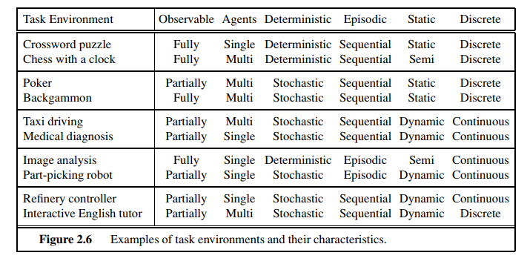

Slide 20
1.8 THE STRUCTURE OF AGENTS
The job of AI is to design an agent program that implements the agent function— the mapping from percepts to actions.
We assume this program will run on some sort of computing device with physical sensors and actuators
we call this the architecture: agent = architecture + program
Following are the main three terms involved in the structure of an AI agent:
  Architecture: Architecture is machinery that an AI agent executes on.
  Agent Function: Agent function is used to map a percept to an action.
  Agent program: Agent program is an implementation of agent function. An agent program executes on the physical architecture to produce function f.
The program we choose has to be one that is appropriate for the architecture.
If the program is going to recommend actions like Walk, the architecture had better have legs.
The architecture might be just an ordinary PC, or it might be a robotic car with several onboard computers, cameras, and other sensors.
In general, the architecture makes the percepts from the sensors available to the program, runs the program, and feeds the program’s action choices to the actuators as they are generated.

Slide 21
Agent programs
The agent programs can take the current percept as input from the sensors and return an action to the actuators.
The difference between the agent program and agent function is, the agent program, which takes the current percept as input, and the agent function, which takes the entire percept history.
The agent program takes just the current percept as input because nothing more is available from the environment; if the agent’s actions need to depend on the entire percept sequence, the agent will have to remember the percepts.
Rather trivial agent program that keeps track of the percept sequence and then uses it to index into a table of actions to decide what to do.
The TABLE-DRIVEN-AGENT program is invoked for each new percept and returns an action each time. It retains the complete percept sequence in memory.
    function TABLE-DRIVEN-AGENT(percept) returns an action
    persistent: percepts: a sequence, initially empty table,
    a table of actions: indexed by percept sequences, append percept to the end of percepts
    action ← LOOKUP(percepts , table)
    return action

Slide 22
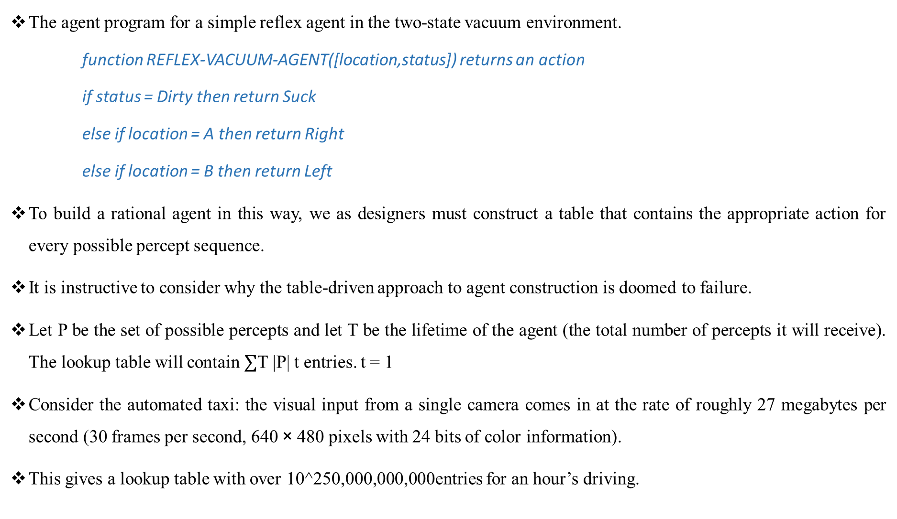
The agent program for a simple reflex agent in the two-state vacuum environment.
    function REFLEX-VACUUM-AGENT([location,status]) returns an action
    if status = Dirty then return Suck
    else if location = A then return Right
    else if location = B then return Left
To build a rational agent in this way, we as designers must construct a table that contains the appropriate action for every possible percept sequence.
It is instructive to consider why the table-driven approach to agent construction is doomed to failure.
Let P be the set of possible percepts and let T be the lifetime of the agent (the total number of percepts it will receive). The lookup table will contain $∑$T |P| t entries. t = 1
Consider the automated taxi: the visual input from a single camera comes in at the rate of roughly 27 megabytes per second (30 frames per second, 640 × 480 pixels with 24 bits of color information).
This gives a lookup table with over 10^250,000,000,000entries for an hour’s driving.

Slide 23
Agents can be grouped into four classes based on their degree of perceived intelligence and capability.
All these agents can improve their performance and generate better action over the time.
These are given below:
          Simple Reflex Agent
          Model-based reflex agent
          Goal-based agents
          Utility-based agent

Slide 24
Simple Reflex agent:
The Simple reflex agents are the simplest agents. These agents take decisions on the basis of the current percepts and ignore the rest of the percept history.
These agents only succeed in the fully observable environment.
The Simple reflex agent does not consider any part of percepts history during their decision and action process.
The Simple reflex agent works on Condition-action rule, which means it maps the current state to action. Such as a Room Cleaner agent, it works only if there is dirt in the room.
Problems for the simple reflex agent design approach:
  They have very limited intelligence
  They do not have knowledge of non-perceptual parts of the current state
  Mostly too big to generate and to store.
  Not adaptive to changes in the environment.
A more general and flexible approach is first to build a general-purpose interpreter for condition– action rules and then to create rule sets for specific task environments.

Slide 25
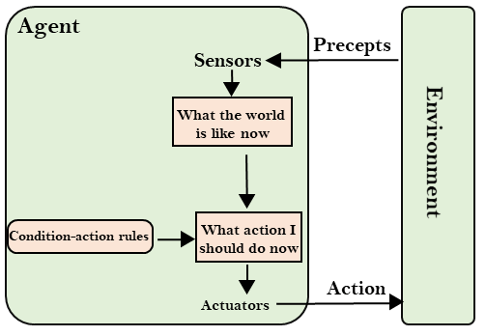
The below Figure gives the structure of this general program in schematic form, showing how the condition–action rules allow the agent to make the connection from percept to action.
We use rectangles to denote the current internal state of the agent’s decision process, and ovals to represent the background information used in the process

Slide 26
A simple reflex agent acts according to a rule whose condition matches the current state, as defined by the percept
          function SIMPLE-REFLEX-AGENT(percept) returns an action
          persistent:- rules:a set of condition–action rules
          state ← INTERPRET-INPUT(percept)
          rule ← RULE-MATCH(state, rules)
          action ← rule.ACTION
          return action
The INTERPRET-INPUT function generates an abstracted description of the current state from the percept, and the RULE-MATCH function returns the first rule in the set of rules that matches the given state description.

Slide 27
Model-based reflex agent
The Model-based agent can work in a partially observable environment, and track the situation.
A model-based agent has two important factors:
  Model: It is knowledge about "how things happen in the world," so it is called a Model-based agent.
  Internal State: It is a representation of the current state based on percept history.
These agents have the model, "which is knowledge of the world" and based on the model they perform actions.
Updating the agent state requires information about:
  How the world evolves?
  How the agent's action affects the world?
These knowledge is embedded to the agent’s program and they help agent to understand how the world works.
Implementation of this knowledge is called the model of the world and the agent that uses this model to decide what action to take called model based agent.

Slide 28
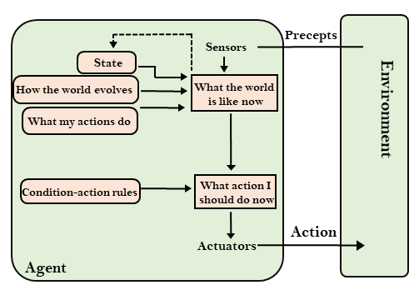
Figure gives the structure of the model-based reflex agent with internal state, showing how the current percept is combined with the old internal state to generate the updated description of the current state, based on the agent’s model of how the world works .
It keeps track of the current state of the world, using an internal model. It then chooses an action in the same way as the reflex agent.

Slide 29
function MODEL-BASED-REFLEX-AGENT(percept) returns an action
persistent: state: the agent’s current conception of the world state
model: a description of how the next state depends on current state and action
rules:a set of condition–action rules action, the most recent action, initially none
state ← UPDATE-STATE(state, action, percept, model)
rule ← RULE-MATCH(state, rules)
action ← rule.ACTION
return action

Slide 30
Goal-based agents
The knowledge of the current state environment is not always sufficient to decide for an agent to what to do.
The agent needs to know its goal which describes desirable situations.
Goal-based agents expand the capabilities of the model-based agent by having the "goal" information.
They choose an action, so that they can achieve the goal.
These agents may have to consider a long sequence of possible actions before deciding whether the goal is achieved or not.
Such considerations of different scenarios are called searching and planning, which makes an agent proactive.

Slide 31
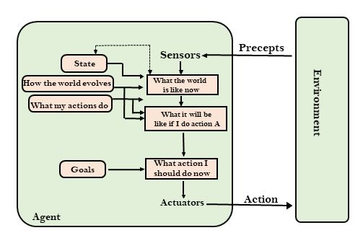
A model-based, goal-based agent. It keeps track of the world state as well as a set of goals it is trying to achieve, and chooses an action that will (eventually) lead to the achievement of its goals.

Slide 32
Utility-based Agents
These agents are similar to the goal-based agent but provide an extra component of utility measurement which makes them different by providing a measure of success at a given state.
Utility-based agent not only focuses on goal(s) but also the best way to achieve the goal(s).
The Utility-based agent is useful when there are multiple possible alternatives, and an agent has to choose in order to perform the best action.
The utility function maps each state to a real number to check how efficiently each action achieves the goals.
A utility-based agent has to model and keep track of its environment, tasks that have involved a great deal of research on perception, representation, reasoning, and learning.

Slide 33
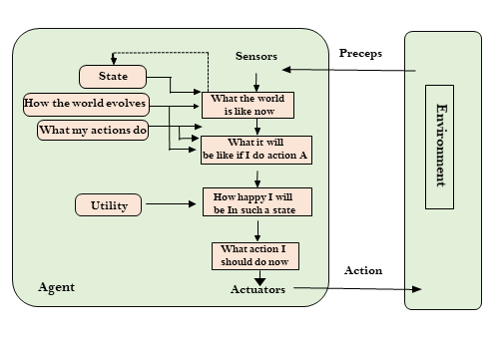
A model-based, utility-based agent. It uses a model of the world, along with a utility function that measures its preferences among states of the world.
Then it chooses the action that leads to the best expected utility, where expected utility is computed by averaging over all possible outcome states, weighted by the probability of the outcome.

Slide 34
Learning Agents
A learning agent in AI is the type of agent which can learn from its past experiences, or it has learning capabilities.
It starts to act with basic knowledge and then able to act and adapt automatically through learning.
A learning agent has mainly four conceptual components, which are:
  Learning element: It is responsible for making improvements by learning from environment.
  Critic: Learning element takes feedback from critic which describes that how well the agent is doing with respect to a fixed performance standard.
  Performance element: It is responsible for selecting external action.
  Problem generator: This component is responsible for suggesting actions that will lead to new and informative experiences.
Hence, learning agents are able to learn, analyze performance, and look for new ways to improve the performance.

Slide 35
